Slide 1
Consistency
From the New York Times Best Selling Book, SPARK: How to Lead Yourself and Others to Greater Success
Notes:
Facilitator Notes:
SPARK is a New York Times best selling book that outlines leadership behaviors which allow us to be more influential and inspirational in our roles.
The authors — Angie Morgan, Courtney Lynch, and Sean Lynch — all served in the US Armed Forces, which is where they all learned that leadership is not about positional authority. Leadership is about behavior. Anyone, at any level, can be a leader. They define leadership as “influencing outcomes and inspiring others.”
The book begins by introducing the SPARK concept. Sparks are the doers and thinkers who envision a better future and work their way towards it. (Facilitator: give some examples of what this looks like in your environment. It could be the sales rep who redefines the sales process, the production manager who rethinks the work flow, or even the receptionist who goes above and beyond to ensure a positive client experience.)
We all can be Sparks. When we begin to see ourselves as part of the solutions we seek, our world changes — we feel more in control, less at the mercy of life’s circumstances, and capable of achieving the “more” we seek in life; whether that’s more responsibility, more opportunity, or even more balance between all the roles we fill.
To be a Spark you need to demonstrate all 7 traits the authors outline. Today we’re going to define one: Consistency.

Slide 2
Group Discussion
How do you define consistency?
Why is consistency an important leadership quality?
Notes:
Facilitator Notes:
Before we discuss consistency, I’d like to ask two questions. (Review questions on the slide with your group.)
Share some of your thoughts to the second question, which could include: consistency allows us to predict behavior, build trust, get into the head of the person we’re working with so we can begin to understand how they think — this helps us take initiative in their absence.

Slide 3
Be consistent
Consistency is your ability to adhere to your values and intentions regardless of your circumstances
Notes:
Facilitator Notes:
SPARK’s authors define consistency as your ability to adhere to your values and intentions regardless of your circumstances.
Over time, this ability allows you to become predictable to others — they can begin to know what to expect from you.
We tend to trust those who we know “are who they say they are,” or follow through on their smallest commitments, or even do what they say they are going to do.
Facilitator: Insert a personal example — you can use an experience of working with someone who is consistent and their impact on you, or even talk about a time when you were less consistent, and the impact on others around you.
Conclude: Clearly this is an important trait of anyone seeking to build influence and provide inspiration to others, which is what leadership is all about.

Slide 4
Developing Consistency
Form readiness habits
Create capacity
Do one less thing
Notes:
Facilitator Notes:
Consistency is a result of habits that you build to help you establish a routine.
Your routine is a needle on a record — it sets you into a groove, that allows you to be steady.
To develop consistency, the authors have offered three guidelines:
Form readiness habits
Create capacity
Do one less thing

Slide 5
Form readiness habits
Practice
Notes:
Facilitator Notes:
Readiness is a military concept, but it’s application is relevant in our world, too.
Readiness is the idea that you’re always prepared for an emergency, crisis, or unplanned surprised — both good and bad.
To be “ready,” you have to treat each day like a rehearsal, which in the military means that you’re always training for war — even during peace time. In the real world, this means that each day you bring your best self to work (or whatever role you fill) and continuously build your expertise in your craft. If you are a leader in the nonprofit world, that may mean going to conferences to stay up to date on issues that matter to the issues you care about. Or, if you’re in IT, it may mean keeping up to date on the latest technology and considering its application in your world.
It all comes down to practice — by practice, it means that you’re staying sharp (not getting dull).
Ask the group what some of their readiness habits are — what conferences do they attend, what books do they read, how do they stay sharp?

Slide 6
Create capacity
White space
Realistic to-do list
Worst first
Notes:
Facilitator Notes:
In SPARK, the authors talk a lot about time management because they know that in order to be consistent, you first need to find time to create capacity — by capacity, we mean the ability to take on “more.”
We can’t manufacture more minutes to do the things we want to do — but we can all do a better job of managing the minutes that we have.
Here are three practices that the authors promote to help you find the time necessary to commit to leading better:
Create white space
Have a realistic to-do list
Tackle the worst first.
Rather than me describe these practices, let’s hear directly from Courtney (the next slide will feature a video of Courtney discussing time management practices)

Slide 7
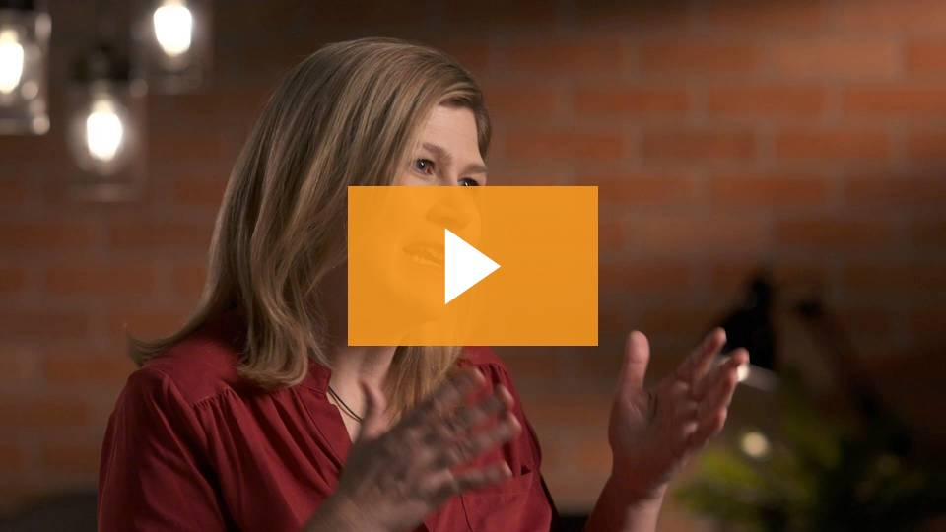
Focus on Consistency
Notes:
Facilitator Notes:
Play video of Courtney discussing time management practices

Slide 8
Group Discussion
Which time management practice do you feel would benefit you the most?
Notes:
Facilitator Notes:
Review screen question with group.

Slide 9
Do one less thing
Deliver the “HBU” test
Notes:
Facilitator Notes:
The final habit the authors promote is to do one less thing, the idea being that maybe — as leaders — we take on too much and spread ourselves too thin, which can be a barrier to being consistent. This impacts our ability to provide focus to our work (and our life), diminishing the quality of our work product and engagement with others.
What often gets us far in our careers is our ability to say yes — yes, I’ll work on Saturdays; yes, I’ll stay late to complete this task. That strategy gets us pretty far in our careers. What gets us further, though, is our ability to say “no.” Not to everything, of course. But “no” to things that aren’t the highest, best use of our time.
That’s the HBU test. HBU stands for Highest, Best Use.
The HBU test can be administered when we feel we’re doing activities that aren’t aligned with our vision or our goals. As leaders, we can do anything, and we’re all motivated to get involved. Yet, it’s not in our best interest to do everything. In reality, we can’t do everything.
Facilitator — describe a time when you took on too much, and the impact it had on the quality of your work. In hindsight, what would you have done differently?
Saying “no” doesn’t mean never — sometimes it means “not now.” Or, saying “no” creates an opportunity to talk about priorities. For example, if you get tasked with a project, your manager might not have awareness what is already on your to-do list. It’s okay to share the other projects that you’re working on and asking them to help you re-prioritize.

Slide 10
Exercise
Notes:
Facilitator Notes:
There are two exercises that can go with this module — we recommend using one of the two in your session. The second can be used as an optional follow-up exercise.
The Consistency Habit: This is an individual exercise where you ask people to reflect on their calendar, answer several questions, and identify two steps they can take to be more consistent. (Once everyone completes this exercise, you can hold a group discussion to see what activities the participants identified.)
Time Management: This is an individual exercise where participants can reflect upon the time management guidance, and see what practices make the most sense for them to implement. This exercise, too, can be turned into a group discussion.
Note: Both of these exercises may be found in the “Resource Library” on the SPARK Experience, under “Handouts” for Chapter 8: Demonstrate Consistency.

Slide 11
Be the Spark
www.sparkslead.us
Notes:
Facilitator Notes:
While you can never prevent the surprises and curveballs that life throws at you, you can manage yourself and your time, and doing this is critical to generating and maintaining consistency as well as keeping the commitments you make to yourself and to others. Consistency is the difference between a one-hit wonder and someone who has lasting success.
I’d like to thank everyone for coming today to discuss Consistency.
As a follow up, we’ll connect (date) to discuss (SPARK Topic)
If you’d like to learn more about SPARK, or view additional learning materials, visit: www.sparkslead.us

