Slide 1
Act With Intent
From the New York Times Best Selling Book, SPARK: How to Lead Yourself and Others to Greater Success
Notes:
Facilitator Notes:
SPARK is a New York Times best selling book that outlines leadership behaviors which allow us to be more influential and inspirational in our roles.
The authors — Angie Morgan, Courtney Lynch, and Sean Lynch — all served in the US Armed Forces, which is where they all learned that leadership is not about positional authority. Leadership is about behavior. Anyone, at any level, can be a leader. They define leadership as “influencing outcomes and inspiring others.”
The book begins by introducing the SPARK concept. Sparks are the doers and thinkers who envision a better future and work their way towards it. (Facilitator: give some examples of what this looks like in your environment. It could be the sales rep who redefines the sales process, the production manager who rethinks the work flow, or even the receptionist who goes above and beyond to ensure a positive client experience.)
We all can be Sparks. When we begin to see ourselves as part of the solutions we seek, our world changes — we feel more in control, less at the mercy of life’s circumstances, and capable of achieving the “more” we seek in life; whether that’s more responsibility, more opportunity, or even more balance between all the roles we fill.
To be a Spark you need to demonstrate all 7 traits the authors outline. Today we’re going to define one: Act With Intent – Making Decisions That Matter.

Slide 2
Group Discussion
What was one of the most important decisions you’ve had to make — how did it impact you?
What process do you use to help make tough decisions?
Notes:
Facilitator Notes:
You are the sum of your decisions. The quality of your life, the strength of your relationships, the stress level you experience, and your career satisfaction are all a result of every choice you’ve made up to this point in life. So how are you doing?
I’d love to hear from you — What were some of the big decisions that led you to where you are now? Also, let’s discuss the process you use for making decisions.

Slide 3
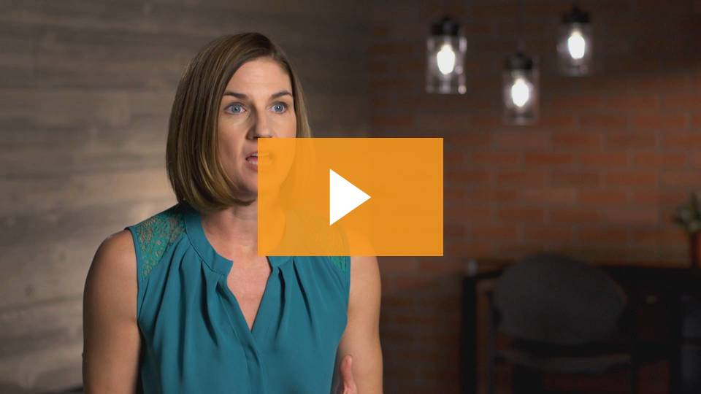
Act With Intent
Notes:
Facilitator Notes:
Making decisions can be incredibly challenging. I’m going to share with everyone a video where Sean and Angie share some thoughts on the important role vision plays in making decisions.

Slide 4
Video Review
Can you recall a time in your life when you lacked a personal vision — when was it, and how did it feel?
How do you develop a personal vision?
Notes:
Facilitator Notes:
Let’s review the video by discussing these two questions:
Can you recall a time in your life when you lacked a personal vision — When was it? How did it feel?
How do you develop a personal vision?

Slide 5
Developing Vision
Notes:
Facilitator Notes:
We all can appreciate what a vision is — yet, how do we go about developing one and what barriers should we be aware of as we take action?

Slide 6
What’s holding us back
Failing to envision what a better life could look like
Falling into routines that bog us down (and prevent us from being a Spark)
Not making decisions that advance us toward our goals
Notes:
Facilitator Notes:
In SPARK, the authors share that developing a vision is easy to understand, but there are key elements that are holding us back:
Failing to envision what a better life could look like
Falling into routines that bog us down (and prevent us from being a Spark)
Not making decisions that advance us toward our goals

Slide 7
Failing to envision “better”
We underestimate all the change we have left to experience
Start by thinking of what you’ve always wanted to do
Write down your thoughts — see what they entail
Develop mentors — seek out their advice
Notes:
Facilitator Notes:
Many of us have a hard time imagining our future. And especially as we get older, we also underestimate how much change we have left to experience.
Harvard social psychologist Dan Gilbert calls this the “End of History Illusion”, that we can appreciate how much we’ve grown over the years, but that we also assume the person we are today is the person we’ll be in the future.
While we may not change as much as we did between the ages of ten and twenty, there’s still a lot of growth left. In other words, we should by no means consider ourselves finished products. We are still very much works in progress.
The goal isn’t necessarily to have a crystal-clear vision of how your life should be at every twist and turn. A vision is more of an idea of what you’re striving toward and an opportunity to raise the expectations you have for yourself and for others.
It starts with thinking about your specific goals, your interests, and the things you’ve always wanted to do — like living overseas, freelancing, or taking on more professional responsibilities. Our pasts, and all the memories they contain, are important reference points for our future.
Be sure to spend some time writing out your thoughts and ideas. Writing is a clarifying process, it helps you connect ideas to tangible actions.
As you develop a vision, seek out others and ask them to share their thoughts on how you can continue to grow. Mentors are a great resource to bounce ideas off of; they can also help clarify our direction by offering us a unique perspective on what they hear and/or are seeing.

Slide 8
Falling into routines that don’t help
Burnout is real
What you say “no” to can be more important than what you say “yes” to
Notes:
Facilitator Notes:
In SPARK, the authors spend a lot of time talking about how we only have 24 hours in each day — and we can only do so much.
They acknowledge that many Sparks love to say “yes,” because their yes’s will lead to opportunity. Too many yes’s, however, and suddenly you don’t have time to focus and take action and/or progress against the things that really matter to you.
In the book, Courtney talks about a time where she became work obsessed; this led to burnout. When her identify became too tightly wrapped up in work, other aspects of her life suffered and, inevitably, she wasn’t living her vision.
Ask: have you ever felt like this? That your identity was too tightly wrapped up in an activity that you didn’t give yourself permission to enjoy other pursuits?
Sparks need to recognize that in order to take intentional action, sometimes you have to let go and start saying “no.” No doesn’t mean never, it just means not now. This not only helps you avoid burnout, but allows you to start to begin to say yes to activities that allow you to achieve your vision.

Slide 9
Not making decisions
Create the structure you need to succeed
Develop a plan*
* A plan is a reference point for change
Notes:
Facilitator Notes:
So far, we’ve discussed the importance of reimaging our future (and setting high expectations), avoiding burnout, and we’ll conclude with talking about the final barrier to acting with intent — not making decisions.
You’ll hear frequently in SPARK that the authors encourage you to spend time reflecting, and writing about the things you’d like to change and/or improve upon.
This is true for developing a vision, and taking action against it. You can have the best intentions for your life, but not achieve them if you don’t act.
Sometimes action requires that you change your circumstances to accommodate your new goals, pursuits, and ambitions — like if you want to go back to school, you need to readjust your schedule to find time to have the hours you’ll need to study and attend classes.
We often fail to take action because we don’t have the right structure in place that supports us. Create the structure you need — that creates the context for change.
Next, develop a plan, which will never be perfect. In SPARK, Angie shares that a plan is a reference point for change. Plans just help you think your decisions through — because they’re future oriented, they’ll never work out just like you envision. But planning helps you consider any friction you might encounter as you go about living your vision.
Share a story: Describe a time in your life when you had to make a major change — talk about the process you went through, and how planning helped.

Slide 10
Exercise
Notes:
Facilitator Notes:
There are three exercises that can go with this module — we recommend using one of the three:
Your Vision: This visioning exercise will help you explore your goals for yourself — both short-term and long-term — and the small actions you can take today to start accomplishing them. (This is a personal exercise, but can be done with a group.)
Burnout: The pace we keep up can unintentionally derail us from achieving the success we seek. Do you feel like you’re near burnout? Take the quiz and see what you can do to get your life — and career — back on track. (Also share the quiz with your colleagues — it can be very helpful to get the team view as it relates to burnout.) We also offer several actions you can take to curb burnout immediately.
100 Day Action Plan: When was the last time you created a plan that will help you focus, personally and professionally, on what you need to do to build the habits that will help you make daily decisions that matter most? This action plan will help you look at your next 100 days and prompt you to identify very specific actions you can take that will lead you toward your vision. (This is a personal exercise.)
Note: These exercises can all be found in the “Resource Library” on the SPARK Experience, under “Handouts” – See Chapter 5: Act With Intent.

Slide 11
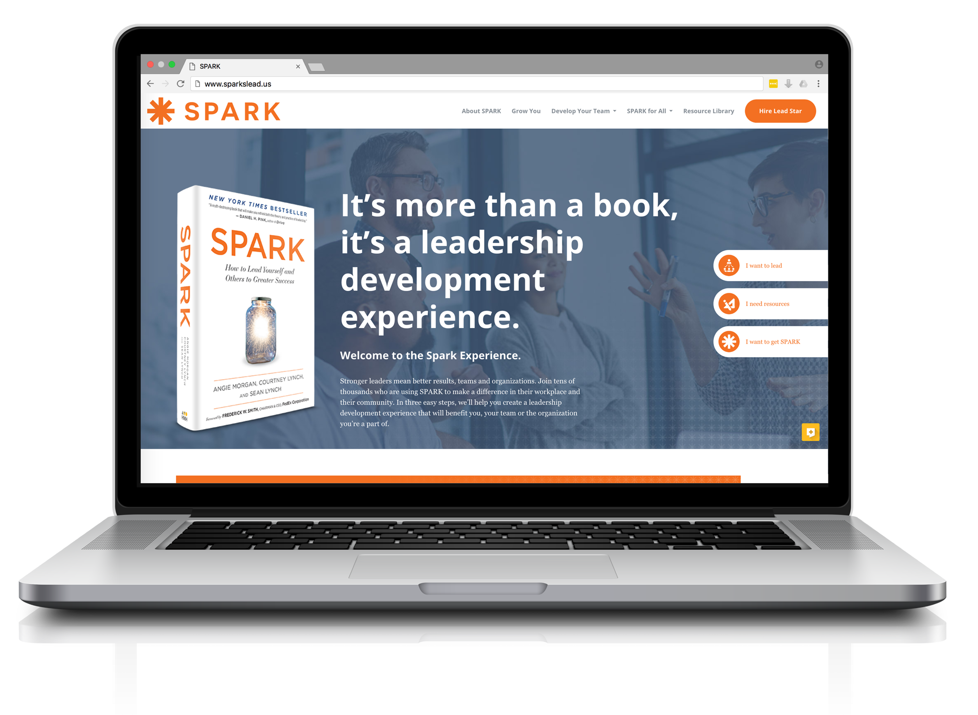
Be the Spark
www.sparkslead.us
Notes:
Facilitator Notes:
There are always going to be the twists and turns that are a natural part of life. Some of those twists can stall you from acting intentionally on the decisions that are most important to you. But as long as you don’t create roadblocks for yourself, you’ll be well on your way to being one of those Sparks who shape their own future so they can lead their life on their own terms.
I’d like to thank everyone for coming today.
As a follow up, we’ll connect (date) to discuss (SPARK Topic)
If you’d like to learn more about SPARK, or view additional learning materials, visit: www.sparkslead.us

